Slide 1
Nourriture - Connect People with Ingredients
Mobile Internet by 2012E
Beijing Jiao Tong University

Slide 2
The Opportunities
Beijing Jiao Tong University

Slide 3
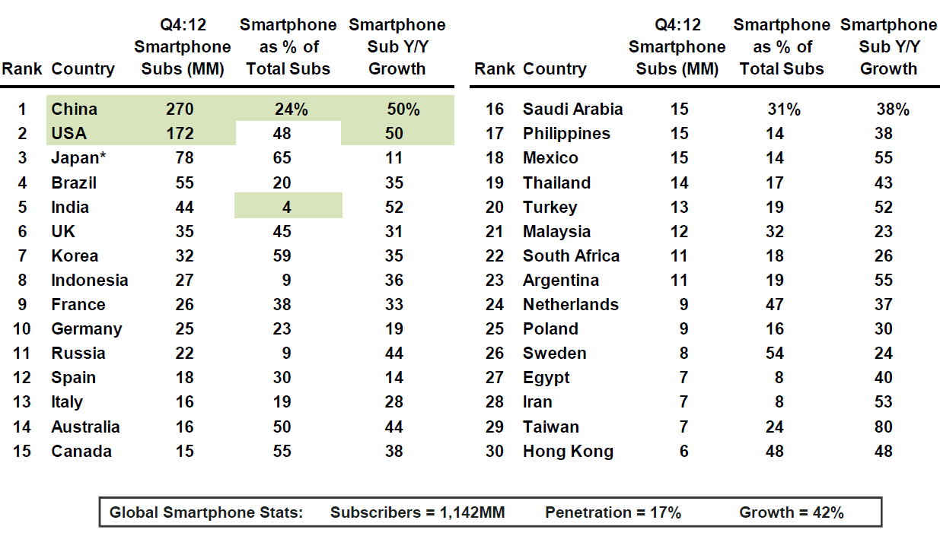
Low Penetration
The numbers of global smart phone subscribers grows 42% to be 1.1 billion, and ONLY 17% of all mobile subscribers are smart phone subscribers.
Beijing Jiao Tong University

Slide 4
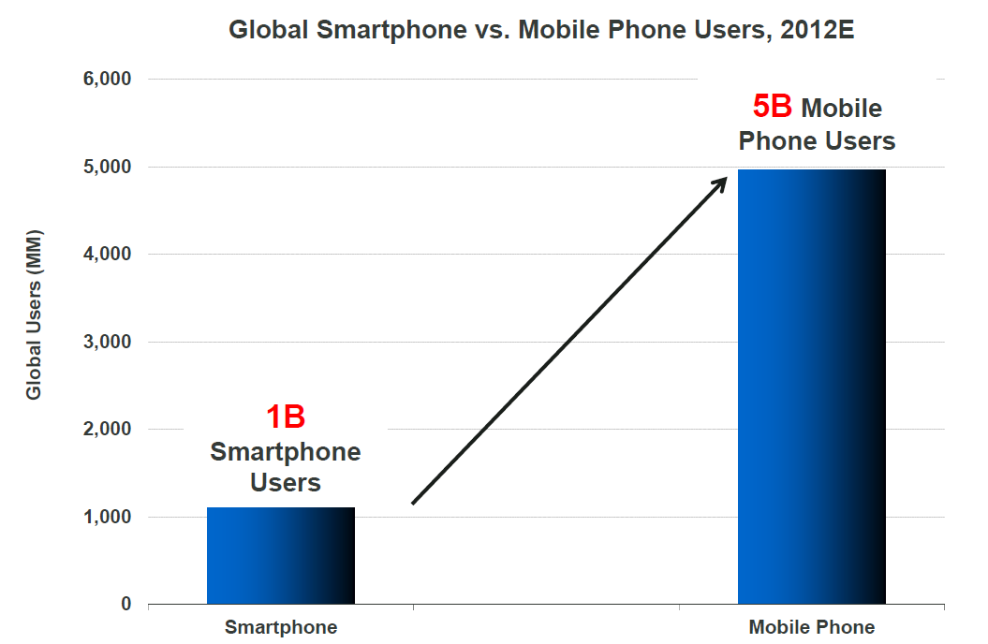
Smartphone Users vs. Mobile Phone Users
Despite tremendous ramp so far (By 2012E), but smart phone users adoption has huge upside that 4B users.
Beijing Jiao Tong University

Slide 5
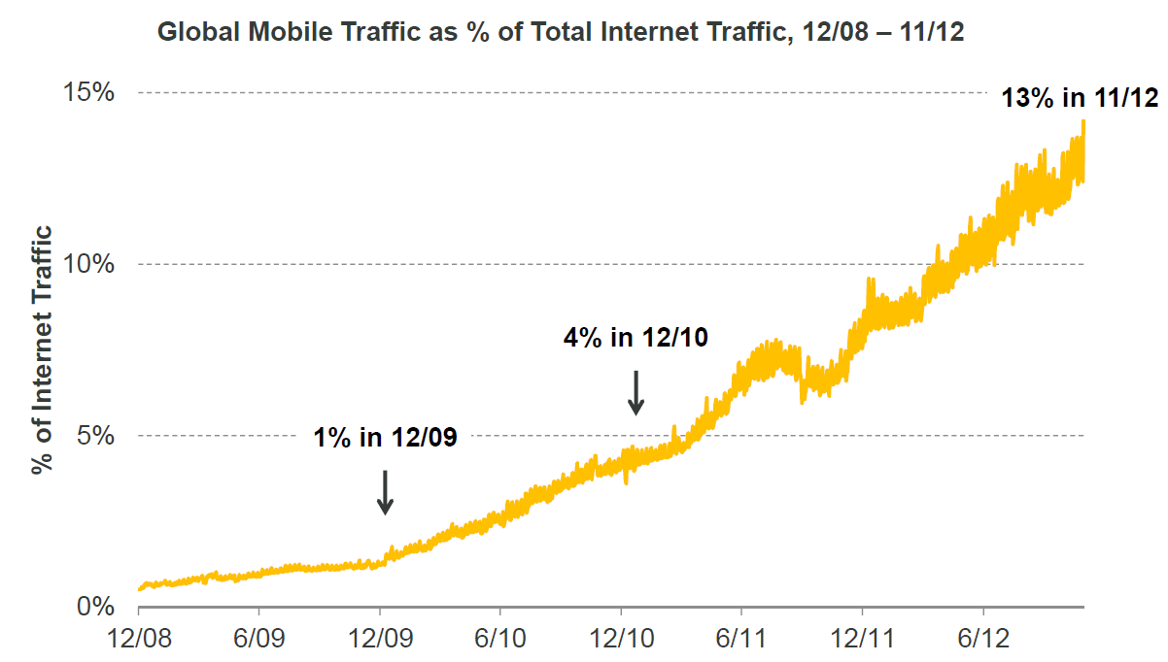
Data Traffic is Kingcraft
Global mobile traffic is growing rapidly to 13% of Internet traffic by 1st half of year 2012.
Beijing Jiao Tong University

Slide 6
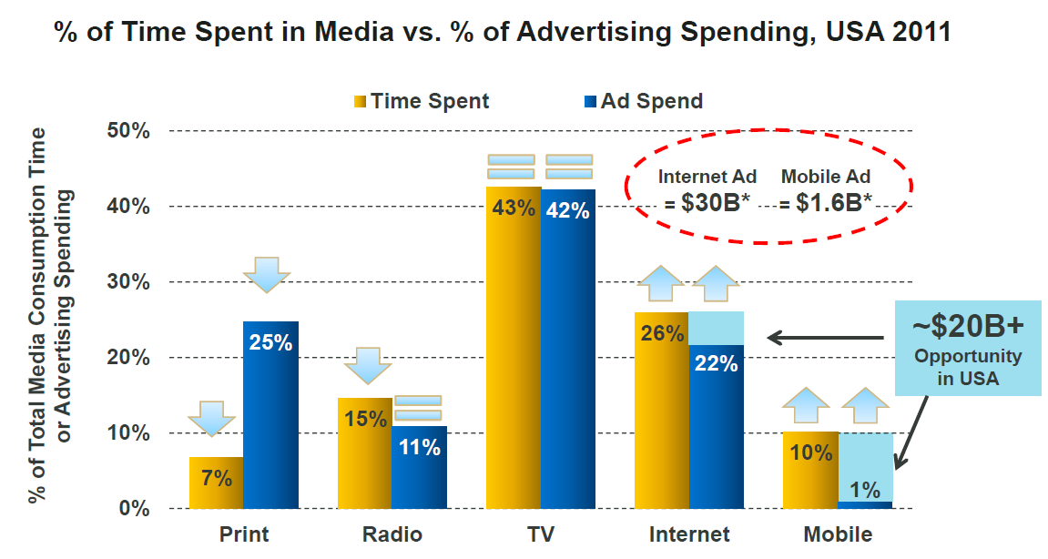
Media Time Spent vs. AD Spending
User spend 10% of time in media consumption while only 1% of AD is spent by 2011 in USA
Beijing Jiao Tong University

Slide 7
The Re-Imagination
Beijing Jiao Tong University

Slide 8
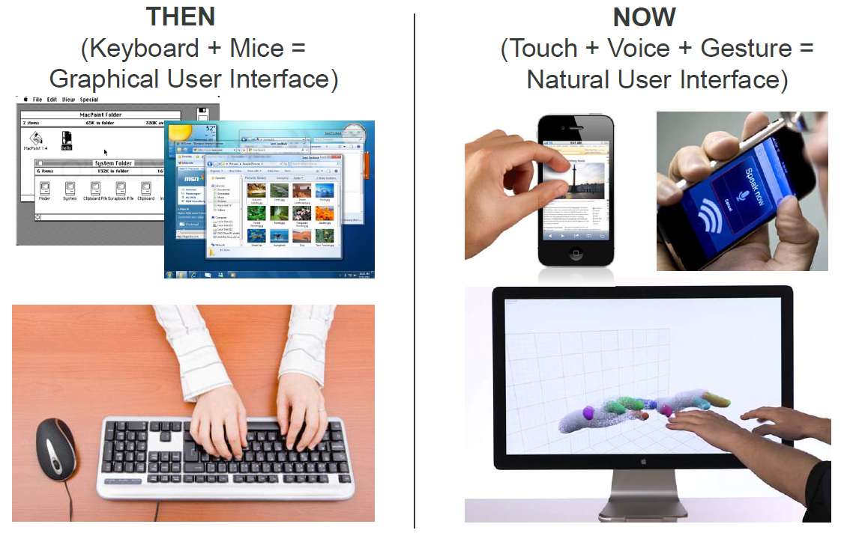
Re-Imagination of User Interfaces
Beijing Jiao Tong University

Slide 9
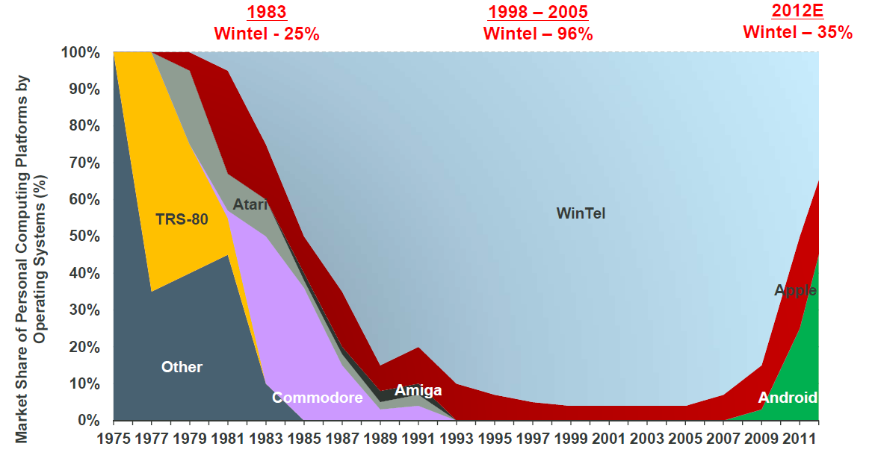
Re-Imagination of OS
By the year 2012E, iOS + Android = 45% marketing share, while Windows reduce the marketing share to 35%
Beijing Jiao Tong University

Slide 10
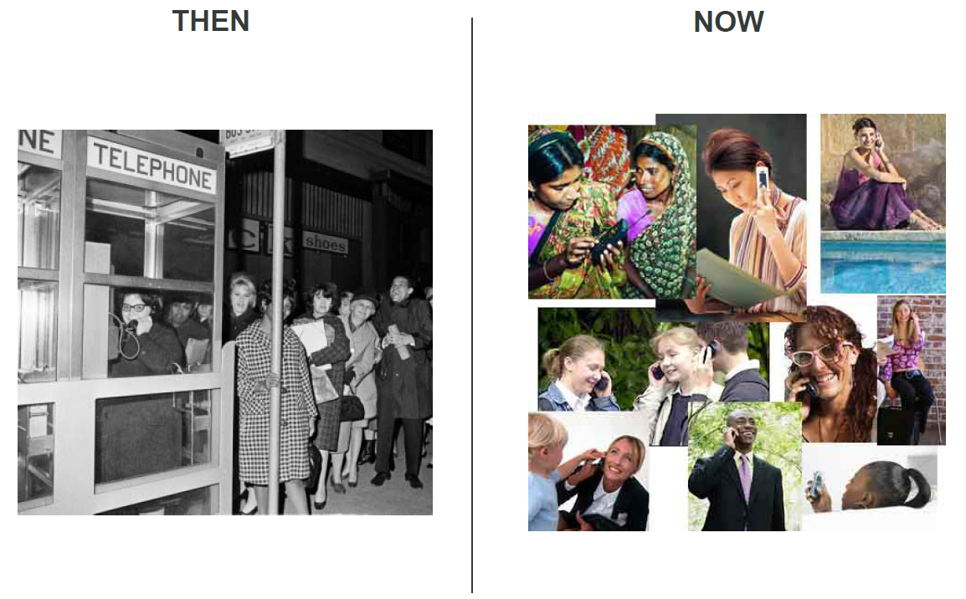
Re-Imagination of Connectivity
Beijing Jiao Tong University

Slide 11
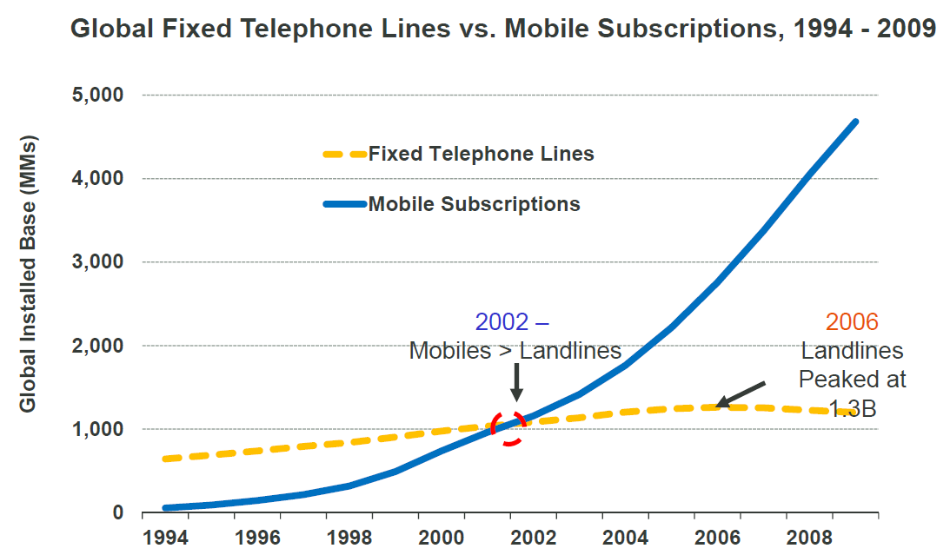
Global Fix Lines vs. Mobile Subscriptions
Operators use 125 years to cumulate the numbers of subscriber to be 1000 MMs, while this number was easily surpassed by the numbers of Mobile subscribers in year 2002.
Beijing Jiao Tong University

Slide 12
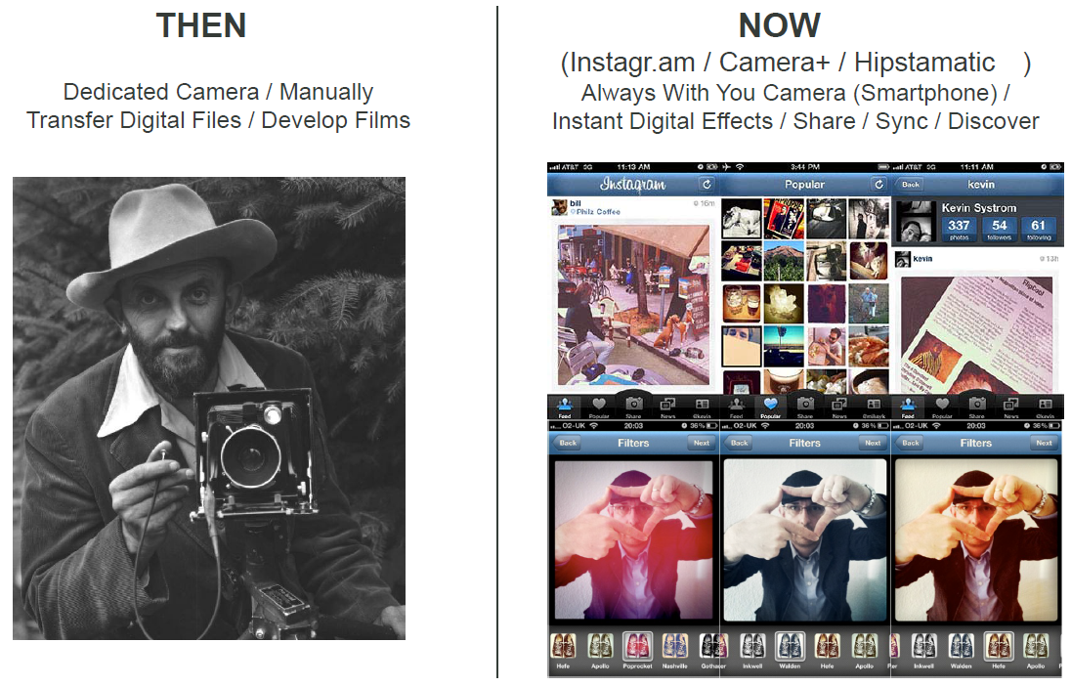
Re-Imagination of Photography
Beijing Jiao Tong University

Slide 13
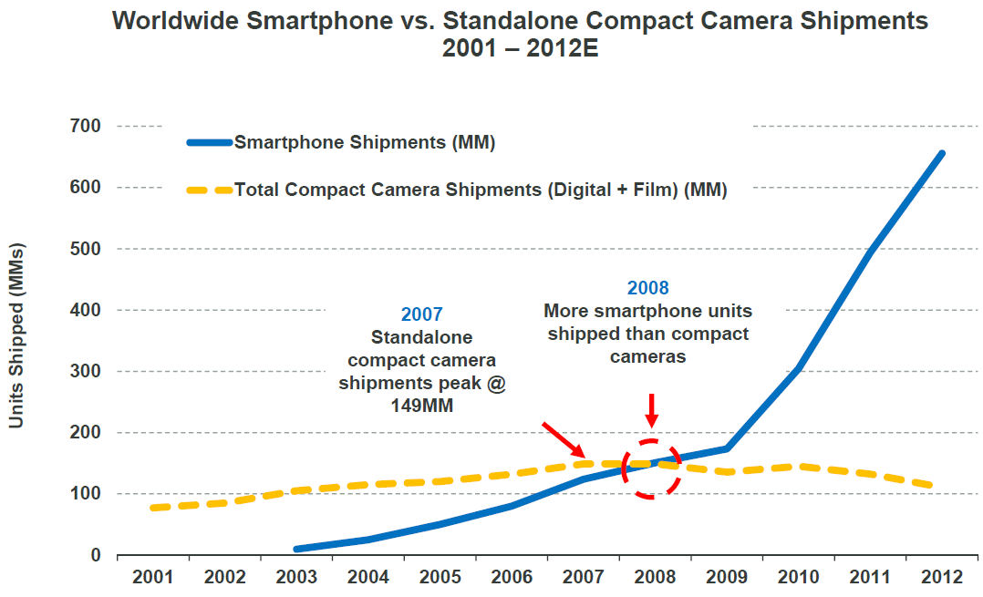
Compact Camera vs. Smartphone (Camera)
169 years in, the shipments of standard compact camera were surpassed by the shipments of Smartphone (with camera) in 2008
Beijing Jiao Tong University

Slide 14
Re-Imagination of a Big Idea
We hope to rewire the way people spread and consume
information We think a more open and connected world
will help create a stronger economy with more authentic
businesses that build better products and services.
- Mark Zuckerberg, Founder / CEO, Facebook
Letter to Potential Shareholders, May 2012
Beijing Jiao Tong University

Slide 15
The Star of Outlook
Beijing Jiao Tong University

Slide 16
It's going to be a fascinating decade
On the horizon – 2011 and Beyond:
HTML5 vs. downloadable apps
NFC (Near Field Communication) for payment / offers / loyalty
Consumer led mobile health for monitoring / diagnosis / wellness
Rapid enterprise adoption of tablets for productivity
Tipping Point (Popular) – > 50% population in developed markets will have Smartphone
“SoLoMo” – Social / local / mobile converging
“Gamification” – Ultimate way to engage a new generation of audiences
Empowerment – impact of empowering billions of people around the world with real-time connected devices has just begun...
More…, such as Wearable devices, Cloud computing, Artificial intelligence
Beijing Jiao Tong University

Slide 17
Big Changes Ahead
We’re at the beginning of a new era for social Internet innovators who are re-imagining and re-inventing a Web of people and places, looking beyond documents and websites.
- John Doerr, Partner, KPCB
Beijing Jiao Tong University

Slide 18
Reference
KPCB: Internet Trends
KPCB: Top Mobile Internet Trends
Beijing Jiao Tong University

